Slide 1
Simple Room Solutions
DMPS Lite and DM Lite

Slide 2


Slide 3
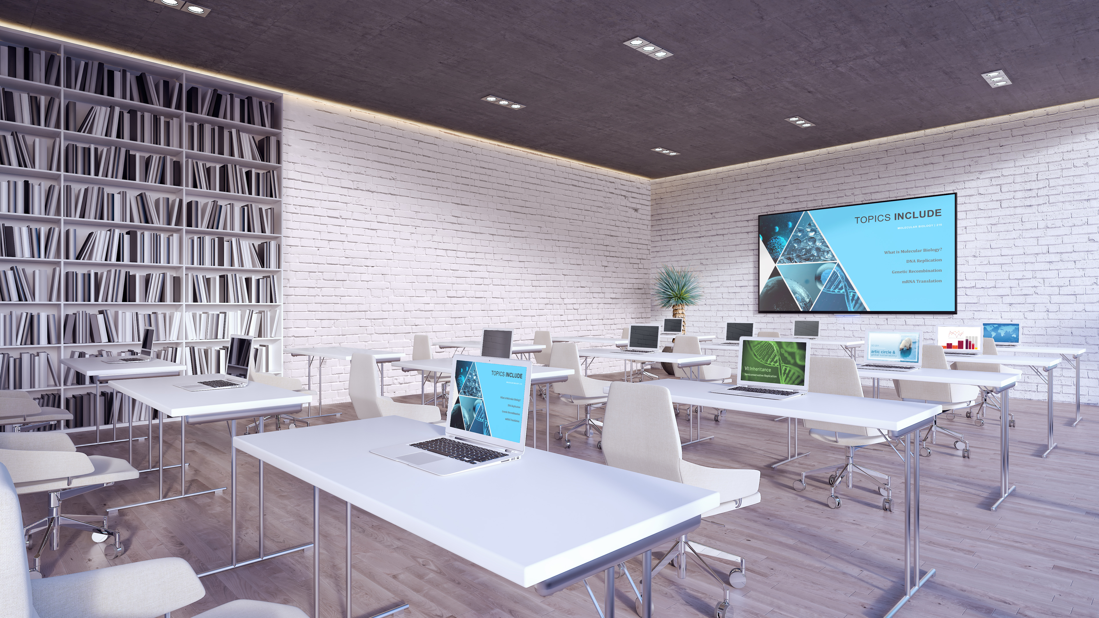

Plug-and-play DMPS Lite™ and DM Lite™ solutions cover all the bases in smaller spaces.
Cost-effective. Flexible. No programming needed.

Slide 4
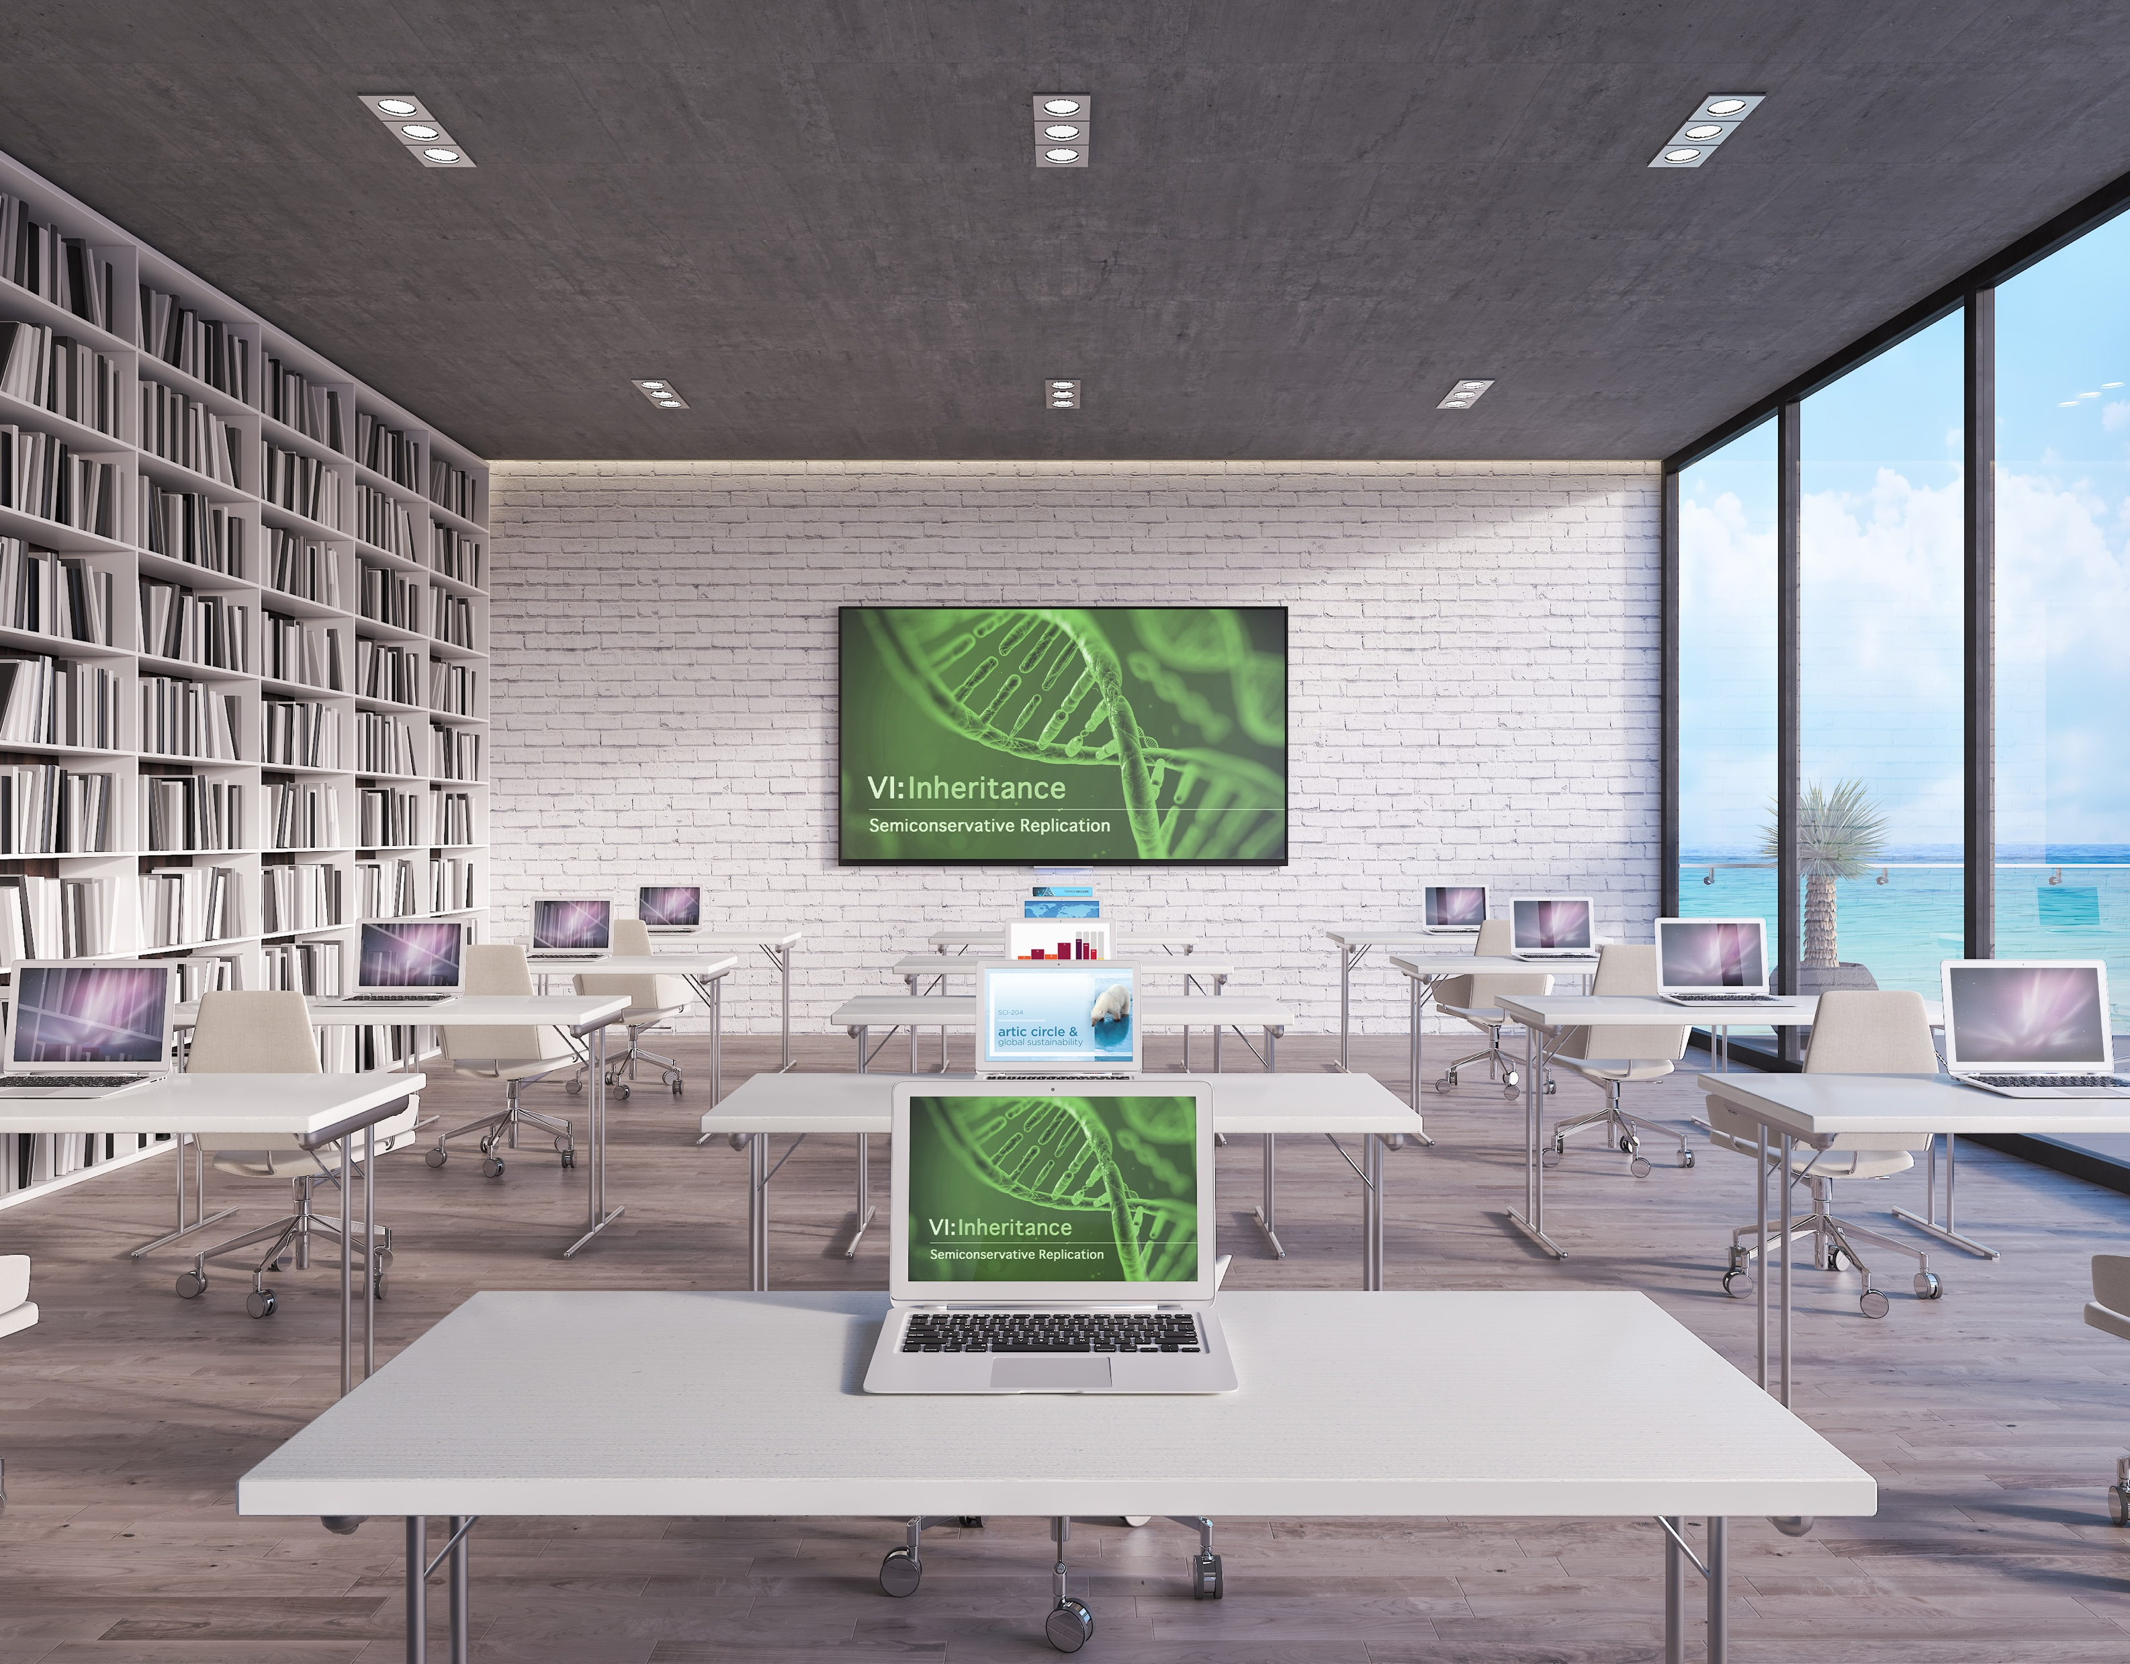
DMPS Lite: Multisource-to-Display
DMPS Lite products give you a high-value all-in-one AV solution for classrooms, huddle rooms, and small collaboration rooms. DMPS Lite expands your reach into spaces that require more than a DM Lite source-to-display solution alone, but less than an all-in-one DMPS3 Series system.

Slide 5
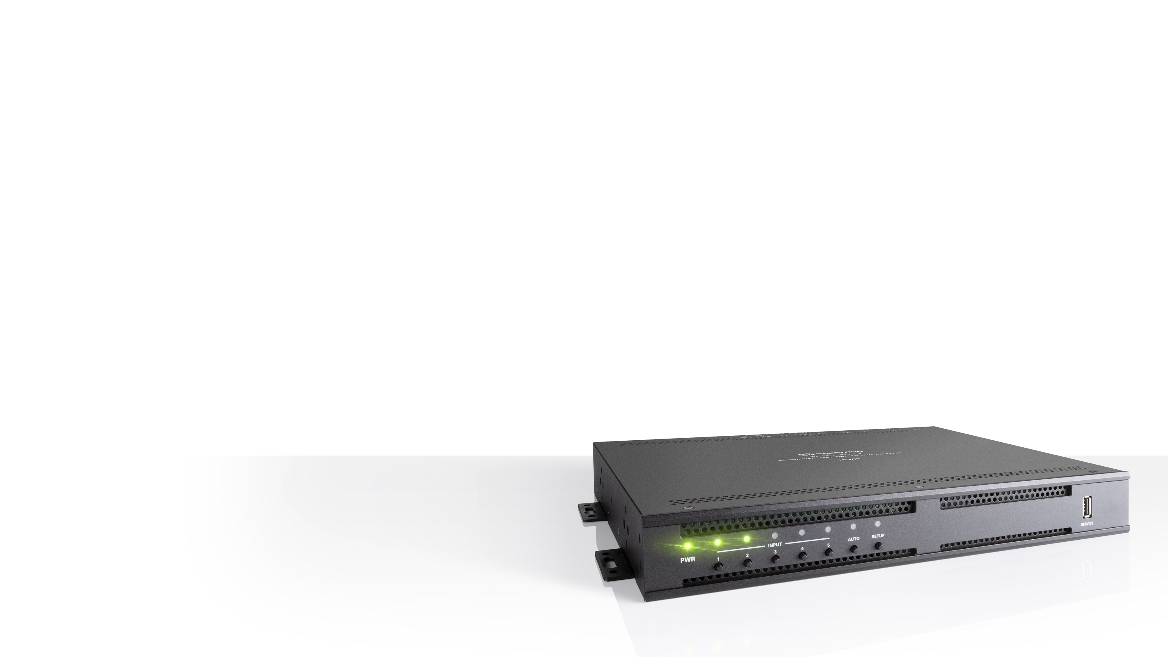
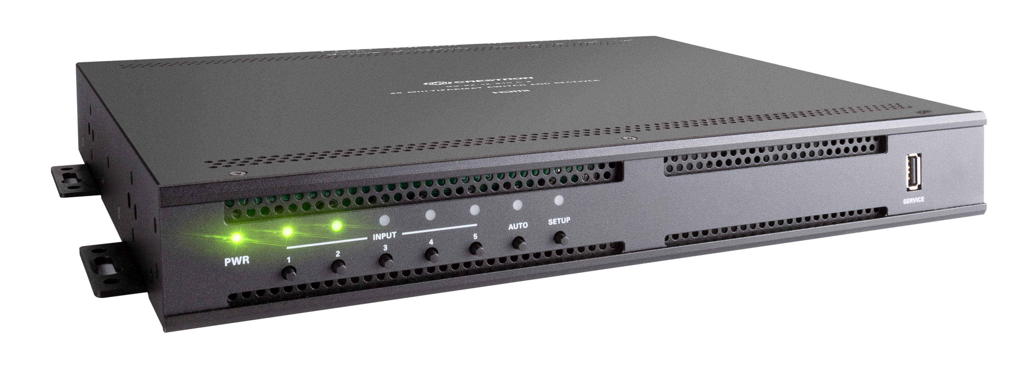
DMPS Lite: Multisource-to-Display
Benefits
Standalone web configuration with auto-routing and display control
Ability to upgrade and monitor via Crestron XiO Cloud™ service
Easily upgrade, service and evolve technology within smaller spaces
Improved network connectivity for high-traffic networks
Features
4K video scaler
Audio amplification (410 and 510 models)
Upgrade, Monitor and evolve with Crestron XiO Cloud™

Slide 6
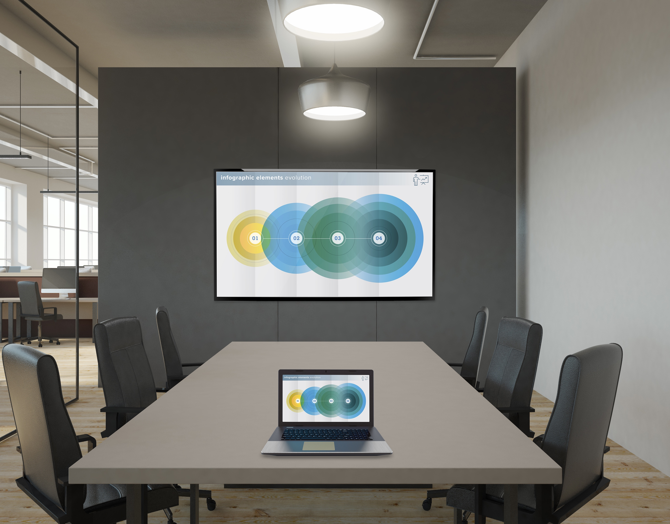
DM Lite: Source-to-Display
Mix-and-match versatile DM Lite transmitters and receivers to create simple systems for most spaces. DM Lite delivers a winning combination of low-cost, yet high-performance. Pair them based on form factor and the type of signals that need to be transmitted along with HDMI®.

Slide 7
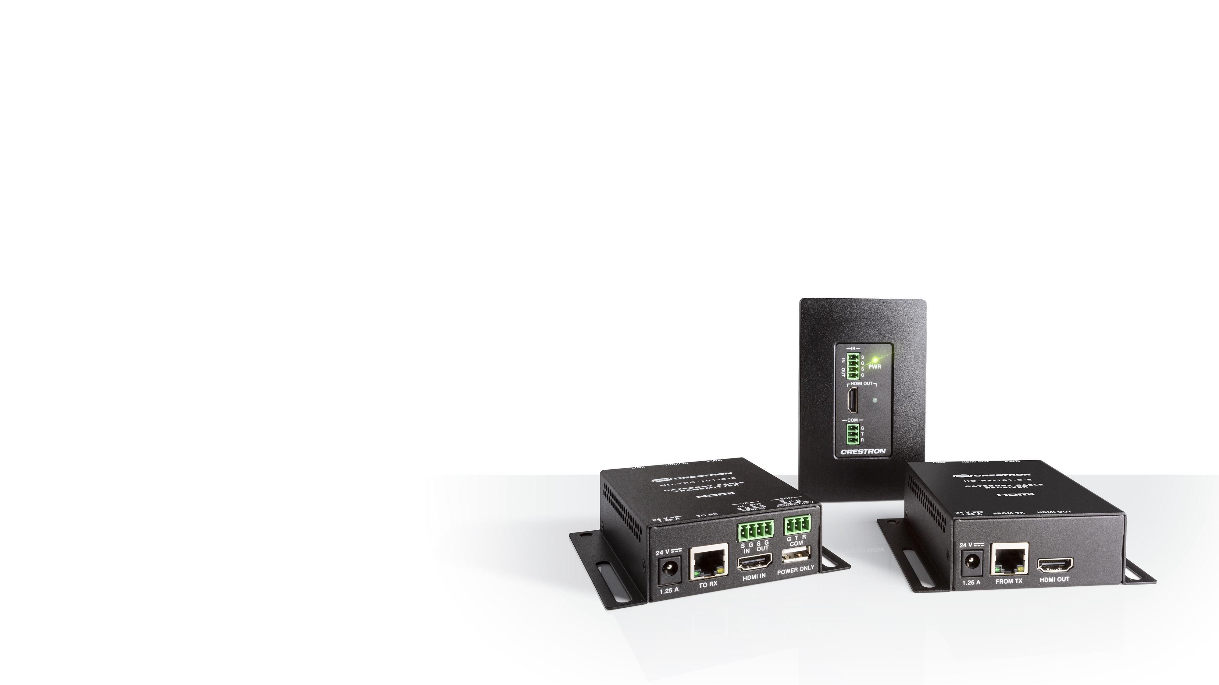
DM Lite: Source-to-Display
Benefit
Mix-and-match DM Lite transmitters and receivers to support the signal extension you need
Audio
Video
Interoperable with DMPS Lite products
Features
Switching and transport of 4K and control signals over standard CAT5e (select models)

Slide 8
What?
Product Lineup

Slide 9
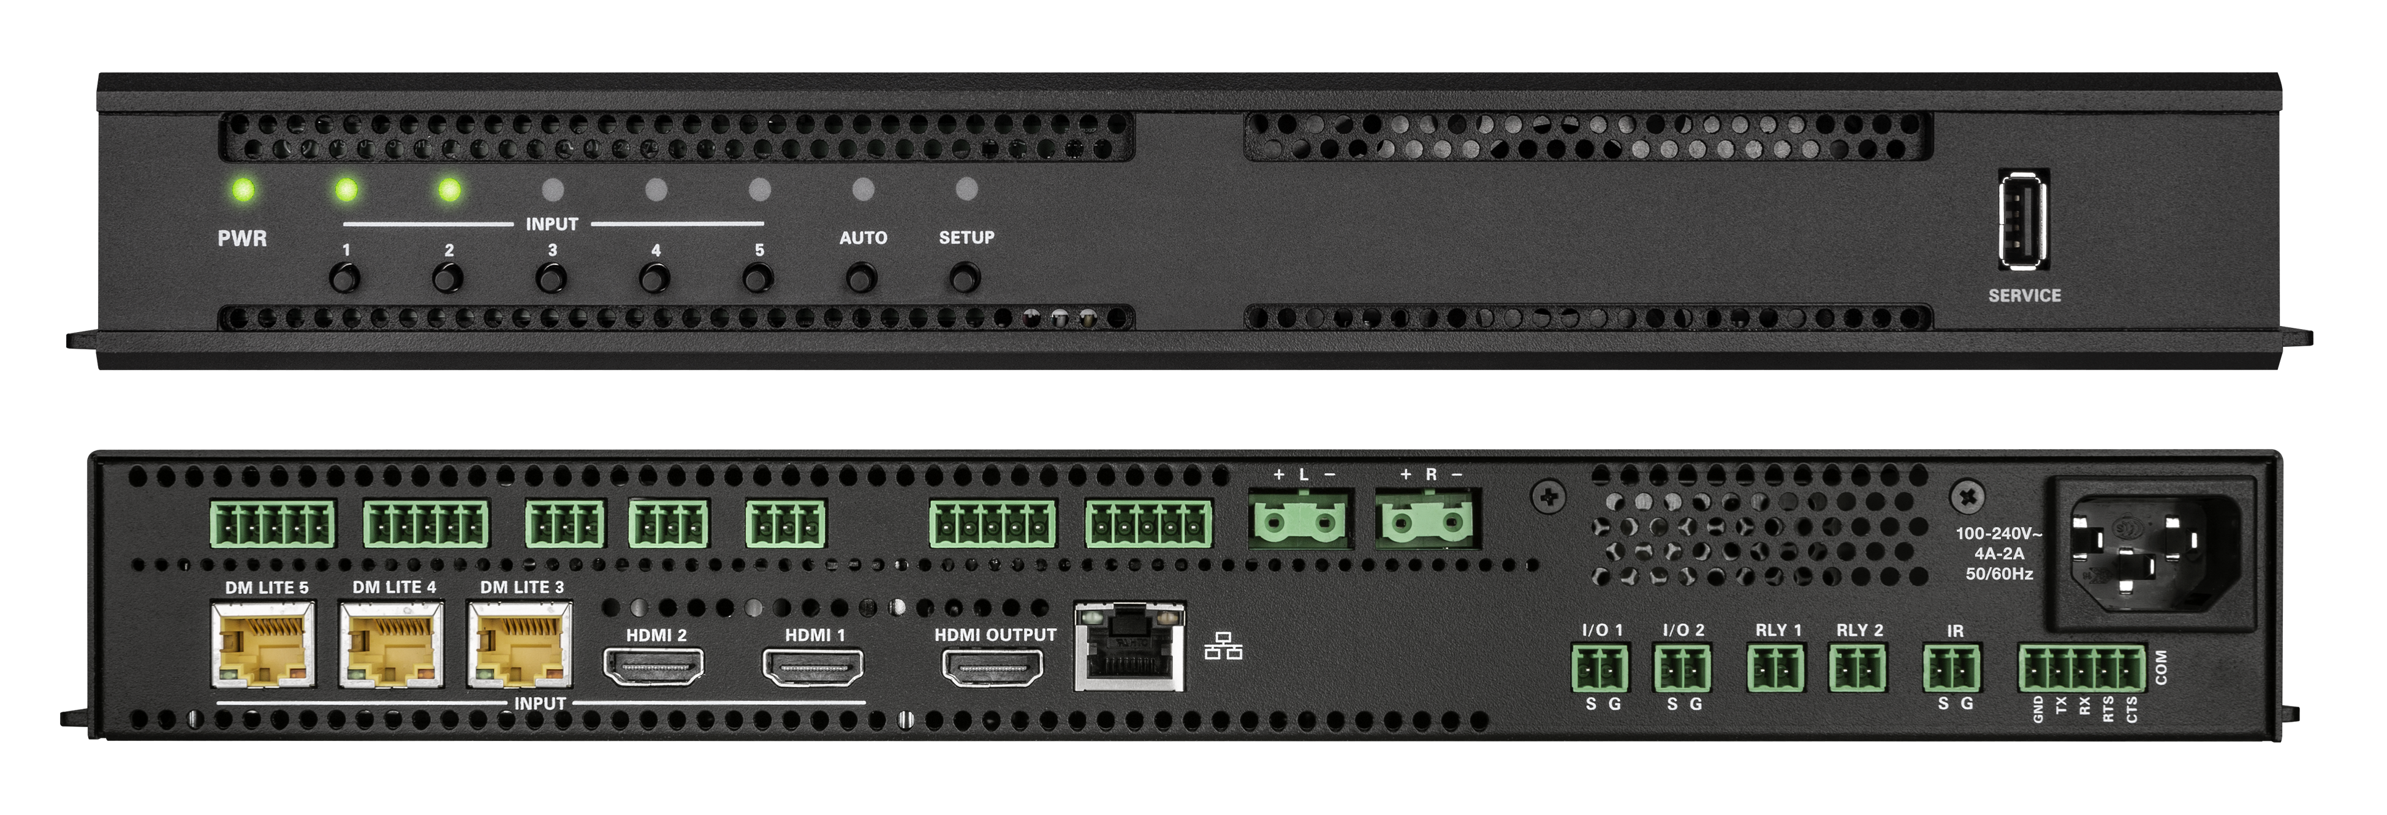
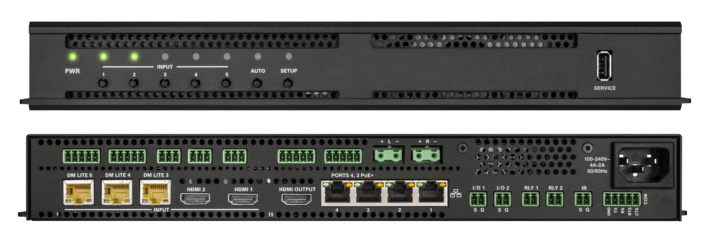
DMPS Lite: Products
HD-RX-4K-510-C-E
4K Multiformat 5x1 AV Switcher and Receiver
HD-RX-4K-510-C-E-SW4
4K Multiformat 5x1 AV Switcher and Receiver with 4-Port Ethernet Switch

Slide 10
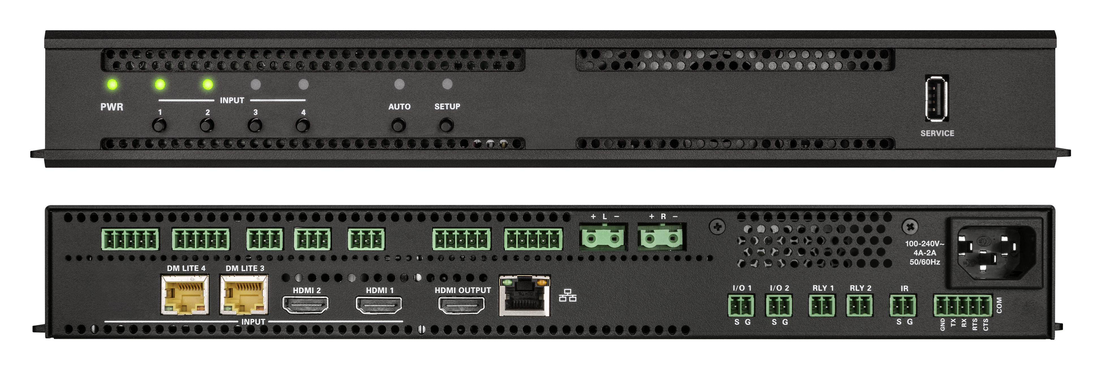
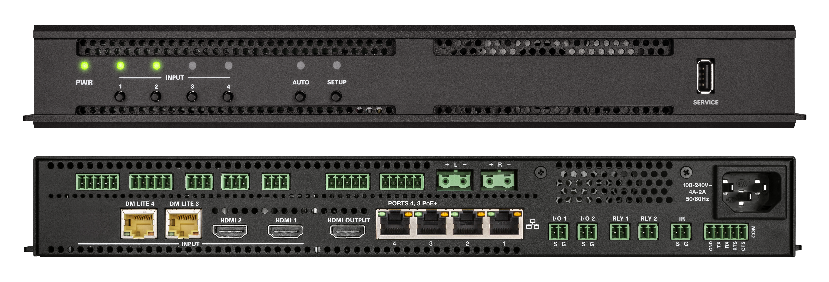
DMPS Lite: Products
HD-RX-4K-410-C-E
4K Multiformat 4x1 AV Switcher and Receiver
HD-RX-4K-410-C-E-SW4
4K Multiformat 4x1 AV Switcher and Receiver with 4-Port Ethernet Switch
Notes:
Sarah – 510 the 410 also has Audio amplification so you can add speakers without needed an amp. Rack or wallmountable
Daniel - Example

Slide 11
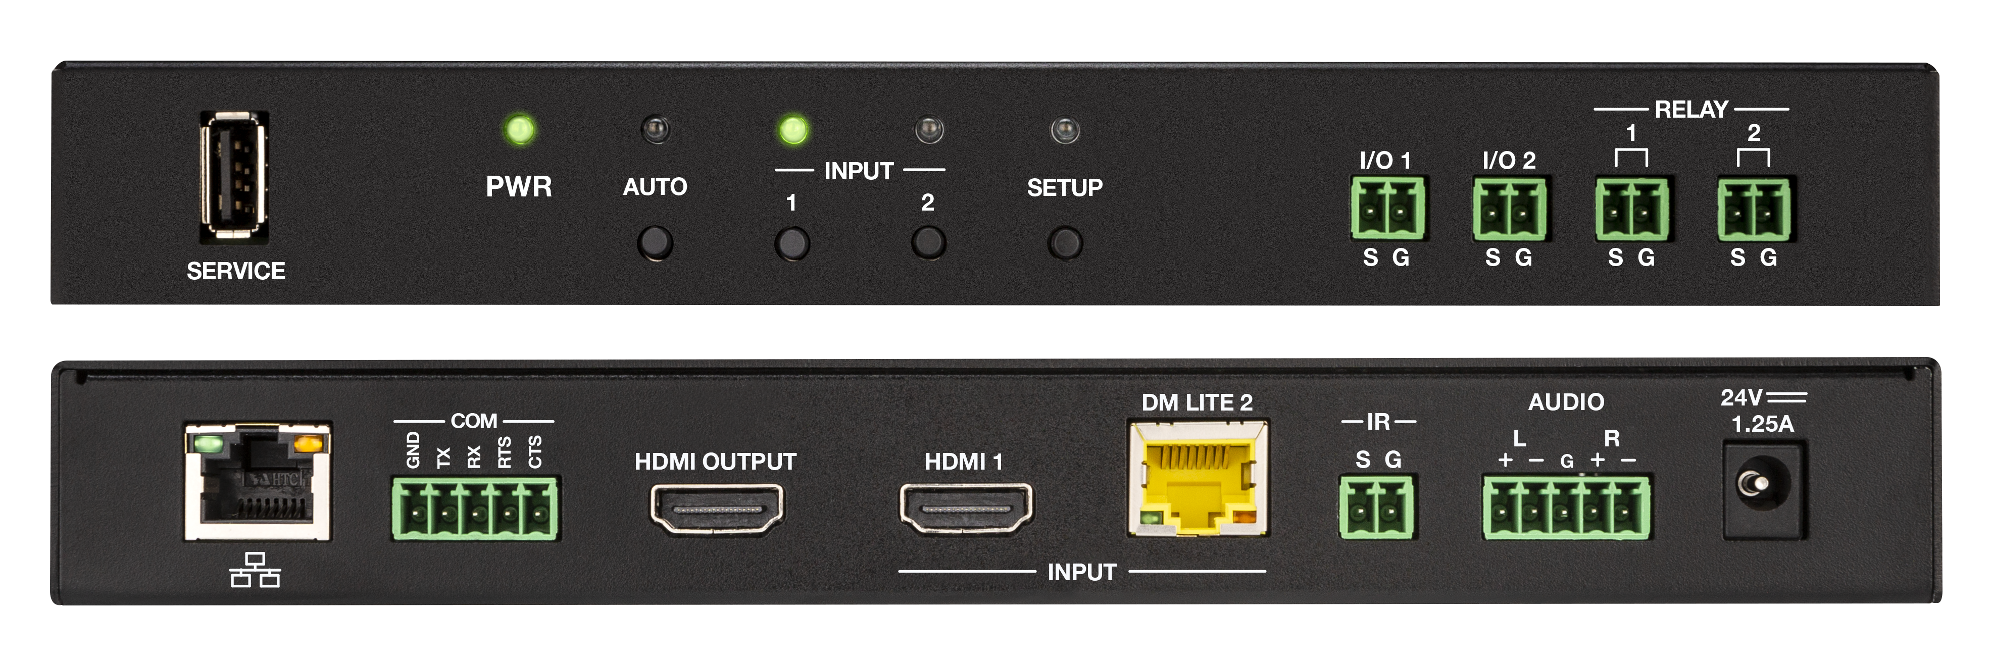

DMPS Lite: Products
HD-RX-4K-210-C-E
4K Multiformat 2x1 AV Switcher and Receiver
HD-RX-4K-210-C-E-PoE
4K Multiformat 2x1 AV Switcher and Receiver w/PoE

Slide 12
DM Lite: Products
Transmitters
HD-TX-101-C-E
HDMI over CATx Transmitter, Surface Mount
HD-TXC-101-C-E
HDMI over CATx Transmitter w/IR & RS-232, Surface Mount
HD-TX-101-C-1G-E
HDMI over CATx Transmitter, Wall Plate
HD-TXC-101-C-1G-E
HDMI over CATx Transmitter w/IR & RS-232, Wall Plate
HD-TX-201-C-2G-E
HDMI over CATx Transmitter & 2x1 Auto-Switcher w/VGA & Analog Audio, Wall Plate
HD-TX-301-C-E
HDMI over CATx Transmitter & 3x1 Auto-Switcher w/2x HDMI plus VGA & Analog Audio, Surface Mount
Receivers
HD-RX-101-C-E
HDMI over CATx Receiver, Surface Mount
HD-RXC-101-C-E
HDMI over CATx Receiver w/IR & RS-232, Surface Mount
HD-RX-101-C-1G-E-B-T
HDMI over CATx Receiver, Wall Plate
HD-RXC-101-C-1G-E-B-T
HDMI over CATx Receiver w/IR & RS-232, Wall Plate
HD-RX-201-C-E
HDMI over CATx Receiver, Room Controller, 2x1 Auto-Switcher, HD Scaler, Surface Mount

Slide 13
How do you get system up and running?
Web Based Configuration

Slide 14
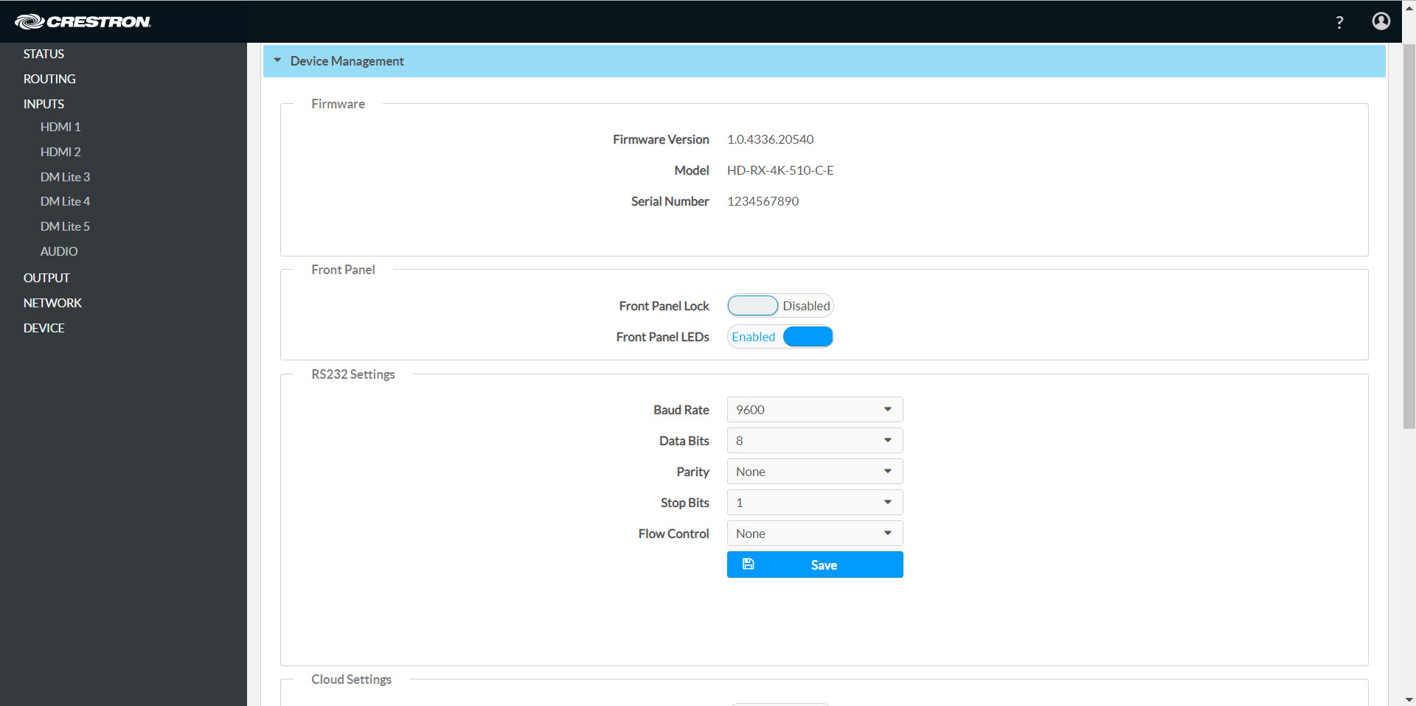
Native Web Based Configuration

Slide 15
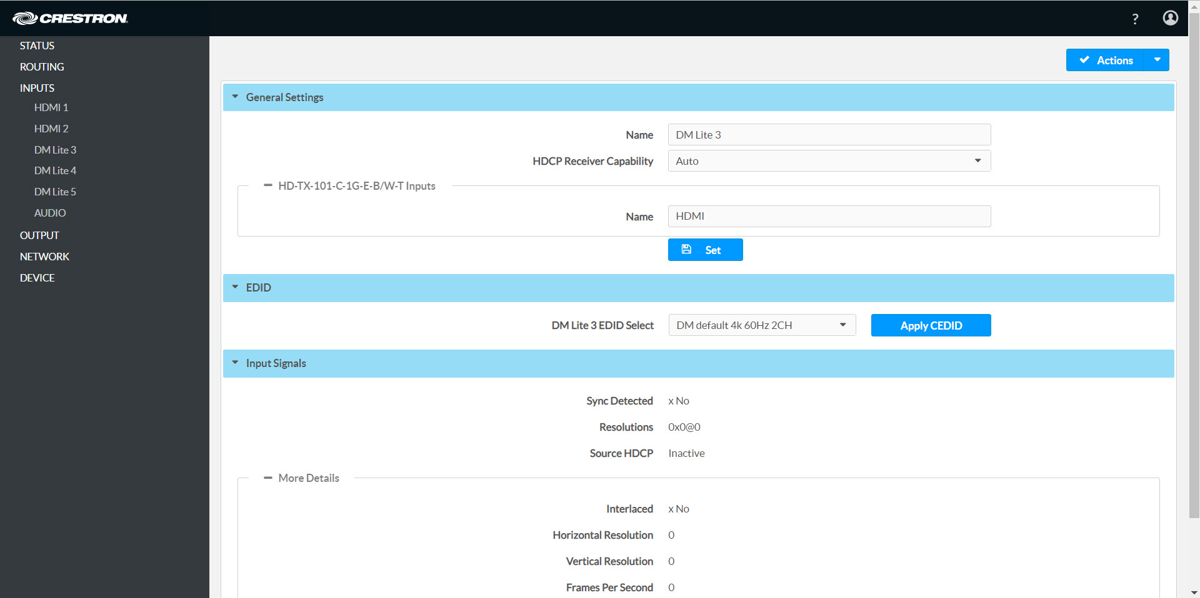
Native Web Based Configuration

Slide 16
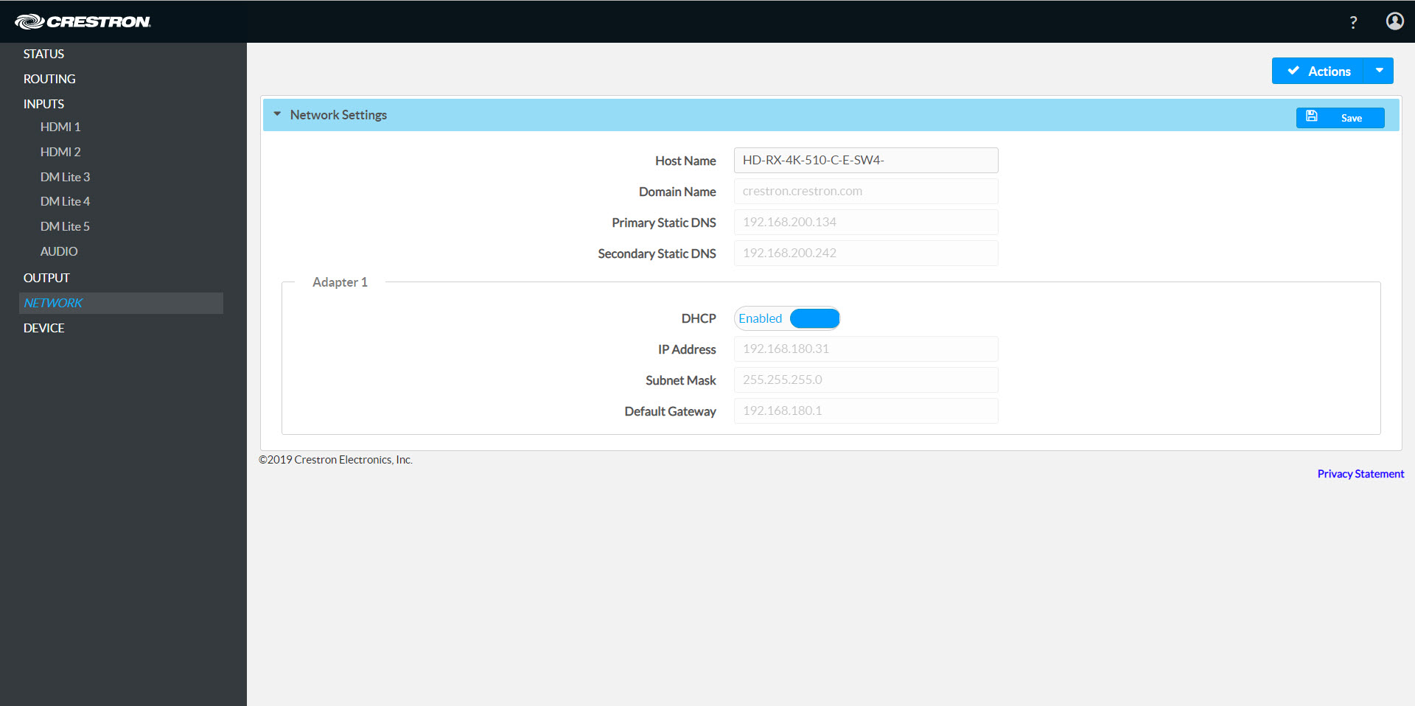
Native Web Based Configuration

Slide 17
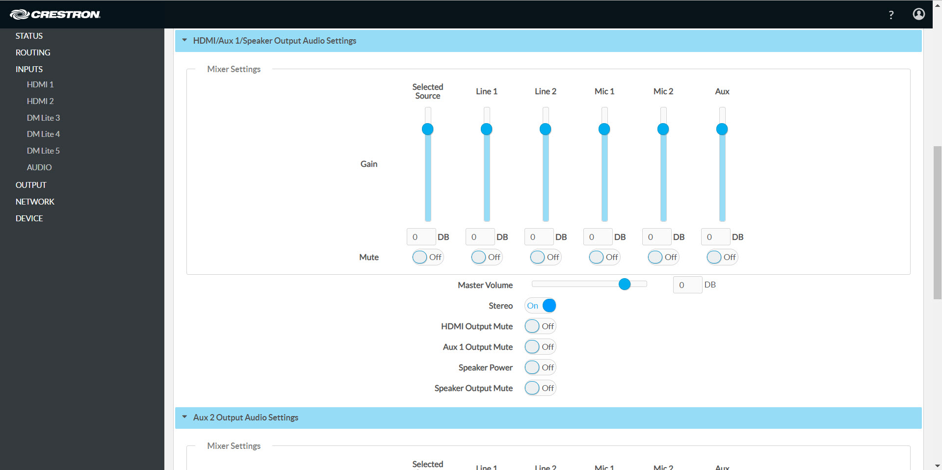
Native Web Based Configuration

Slide 18
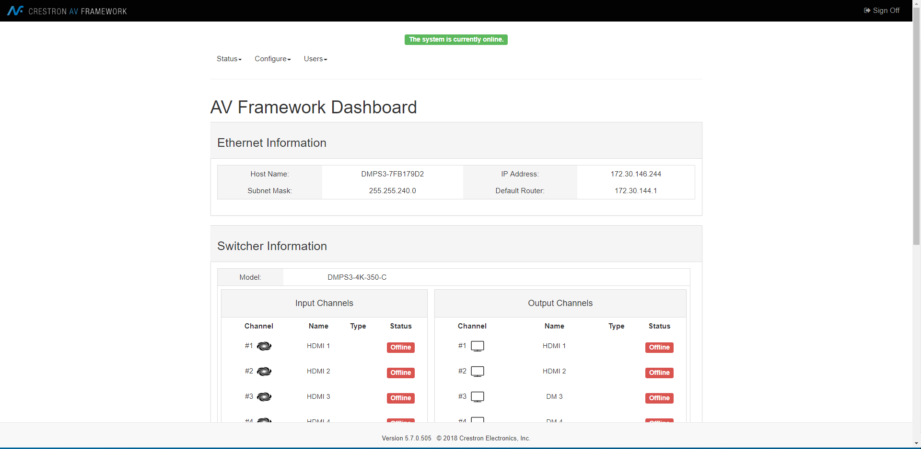
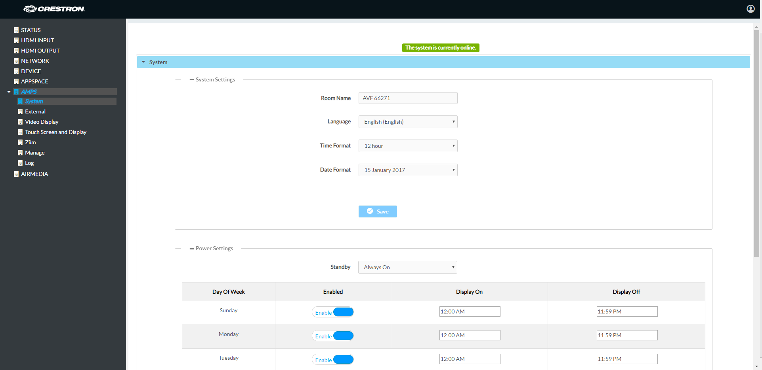


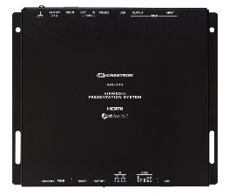
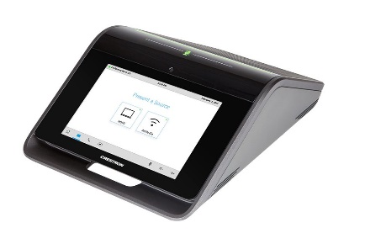
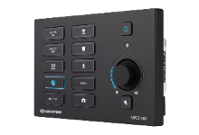
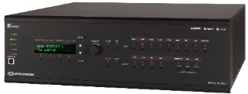
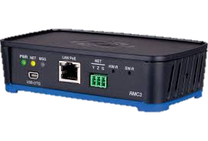
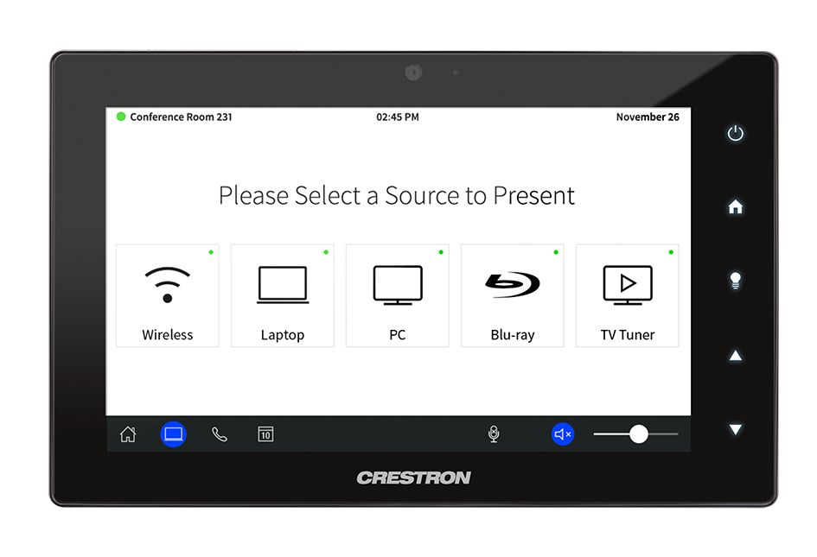
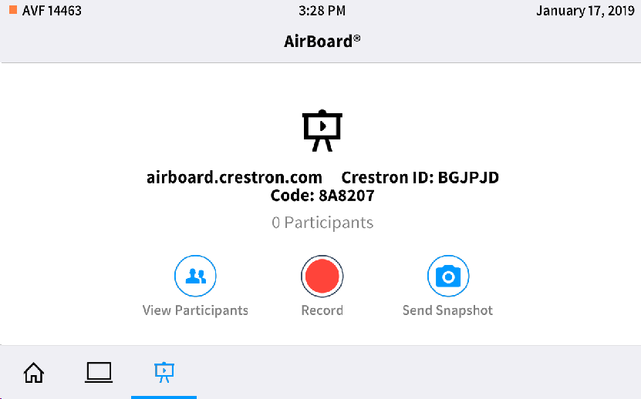
.AV Framework – Web based Configuration
1. Processor
2. Configuration UI
AVF Config
On DMPS/VC-4/MPC3/RMC3
AVF Config
On Mercury/AM
3. User facing UI

Slide 19
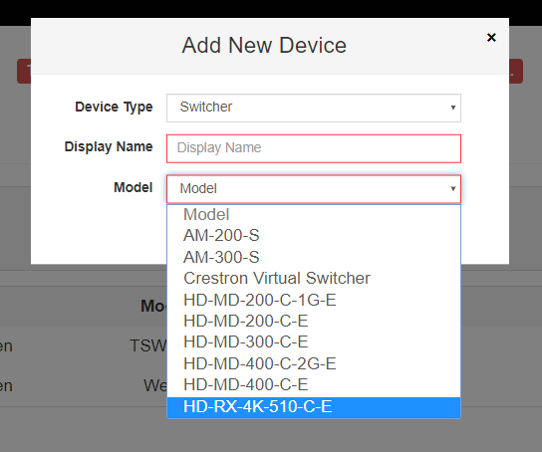
As simple as 1, 2 , 3
Step 1 – Install
Simply install .AV Framework on an MPC3 or RMC3, add the HD-RX-4K-510-C-E as a switcher.
1. Install the Hardware

Slide 20
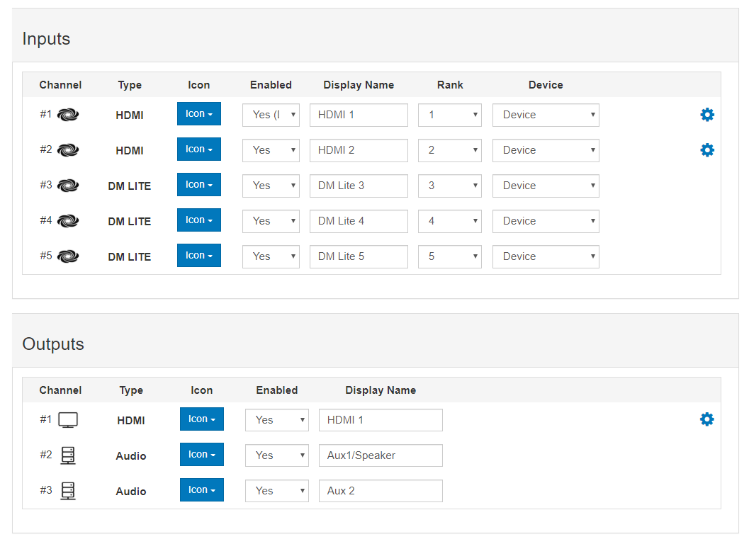
As simple as 1, 2 , 3
Step 2 - Configure
Configure the A/ V Routing
2. Configure A/V Routing

Slide 21
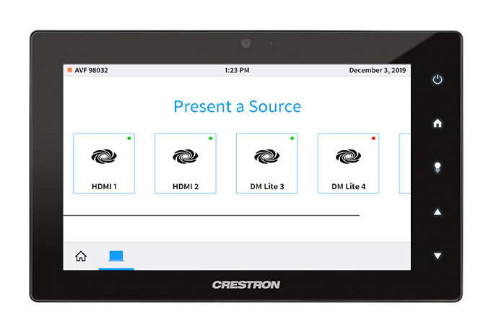
As simple as 1, 2 , 3
Step 3 – Deploy
Your ready to go! Pick a source and start sharing.
AV Framework v6.2
3. Deploy the System

Slide 22
Applications
Vertical Markets

Slide 23

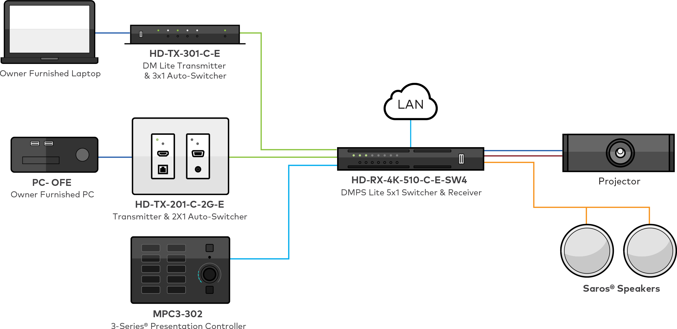
Applications: Education
Classrooms
Lounges
Training rooms
Common spaces
Faculty and student meeting rooms

Slide 24

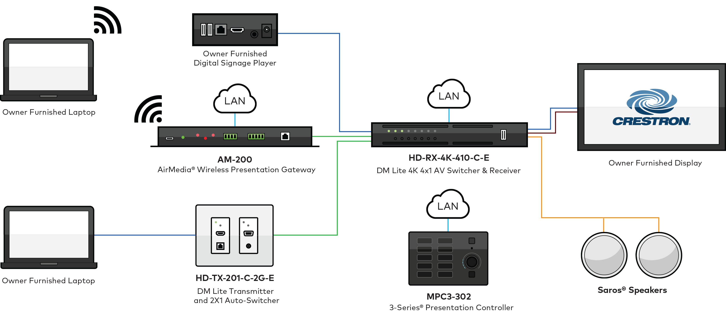
Applications: Enterprise
Meeting rooms
Huddle rooms
Open presentation spaces
Conference rooms
Cafeterias

Slide 25

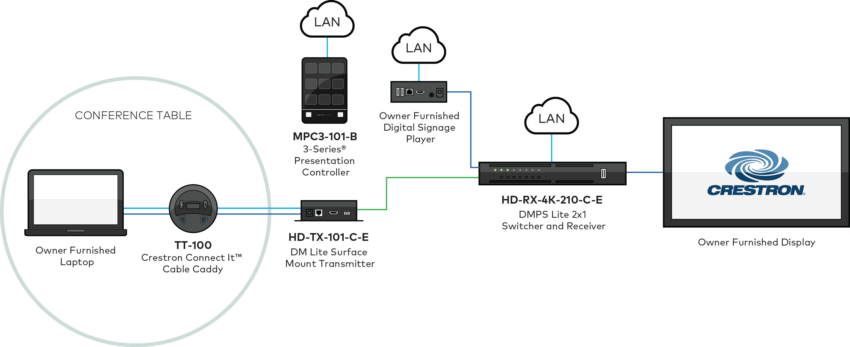
Applications: Government
Meeting rooms
Huddle rooms and spaces
Courtrooms(Simple)
Council rooms
Small briefing rooms
Presentation rooms

Slide 26

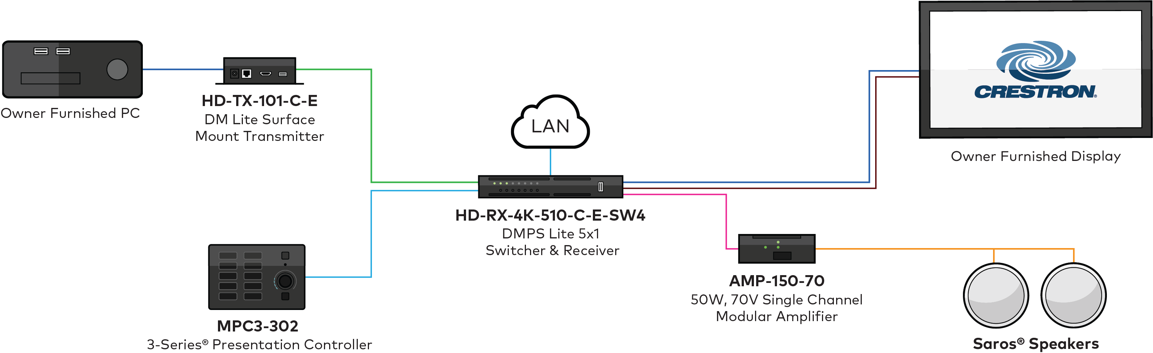
Applications: Retail
Shop Front
Directories (Kiosks)
Break rooms
Retail space

Slide 27

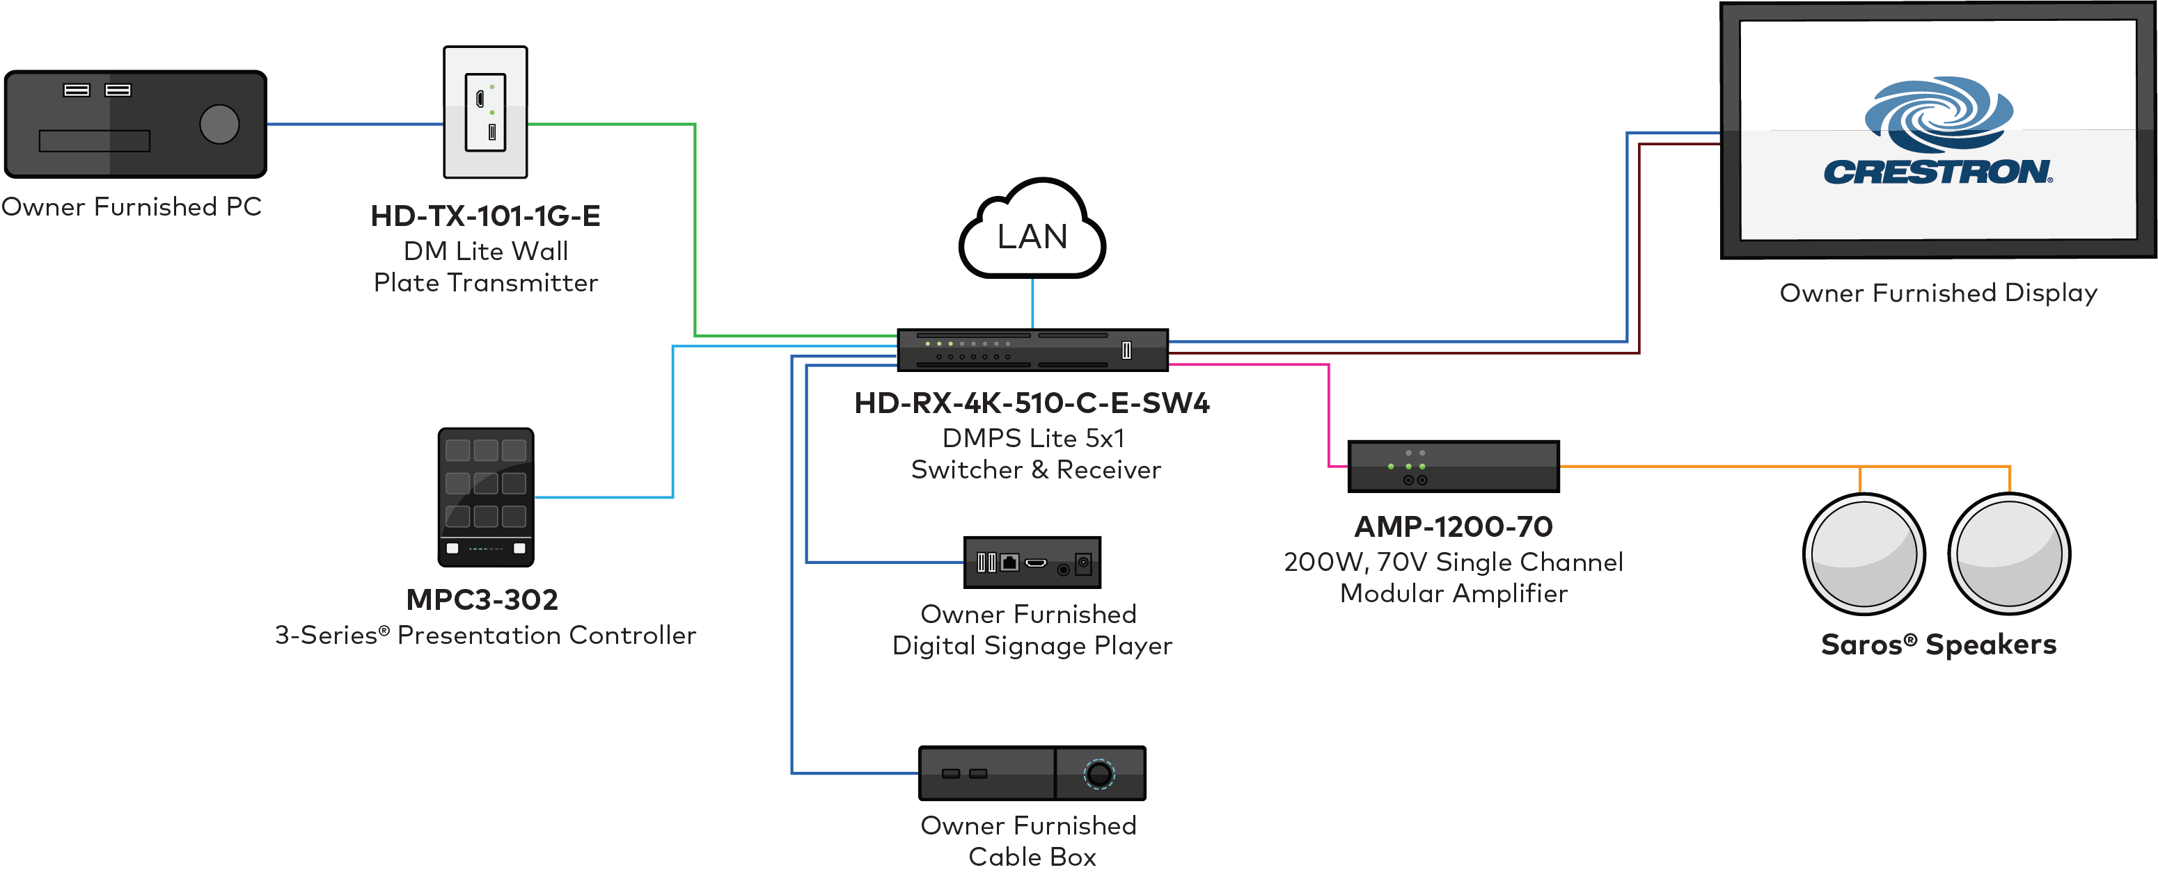
Applications: Hospitality
Guest rooms
Lobbies
Casino gaming rooms
Briefing rooms sporting venues

Slide 28
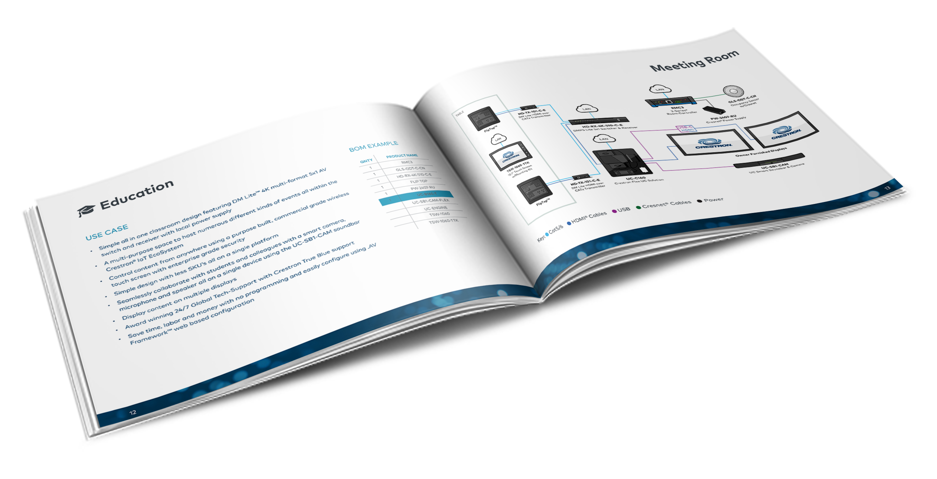
Resources at crestron.com/DMPSLite
DM Lite & DMPS Lite Design Guide
DM Lite & DMPS Lite Application Guide

Slide 29
Simple Room Solutions
Q & A

Slide 30
Simple Room Solutions
DMPS Lite and DM Lite
Notes:
https://vimeo.com/368343973

